Slide 1
PUBLIC KEY CRYPTOGRAPHY
RSA Algorithm

Slide 2
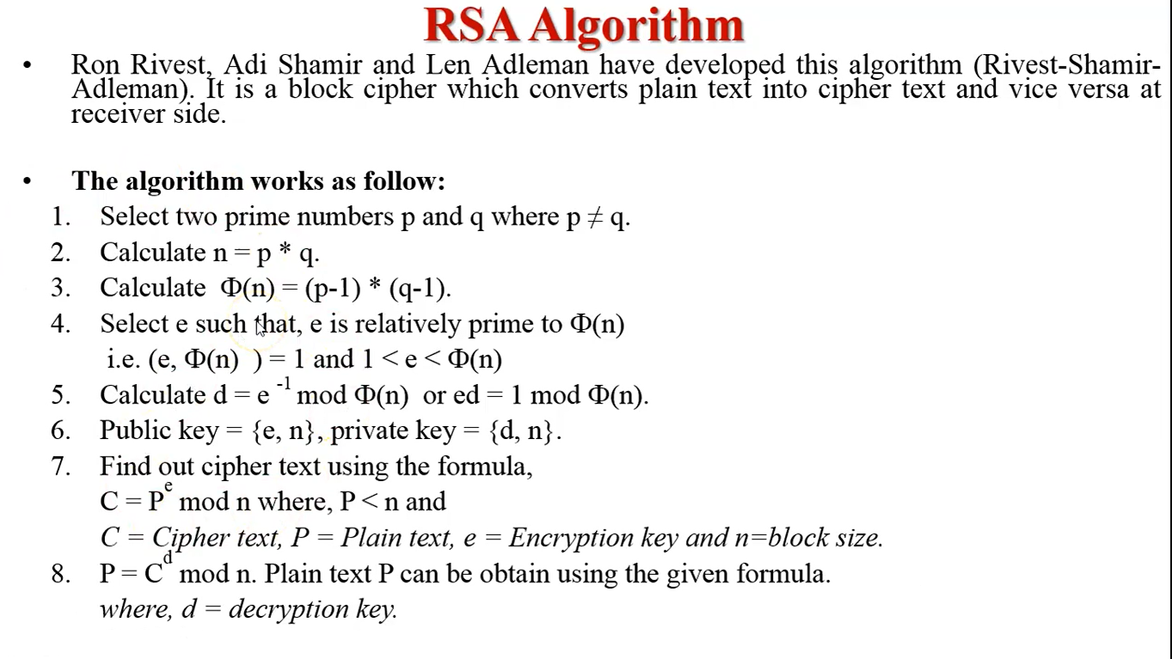

Slide 3
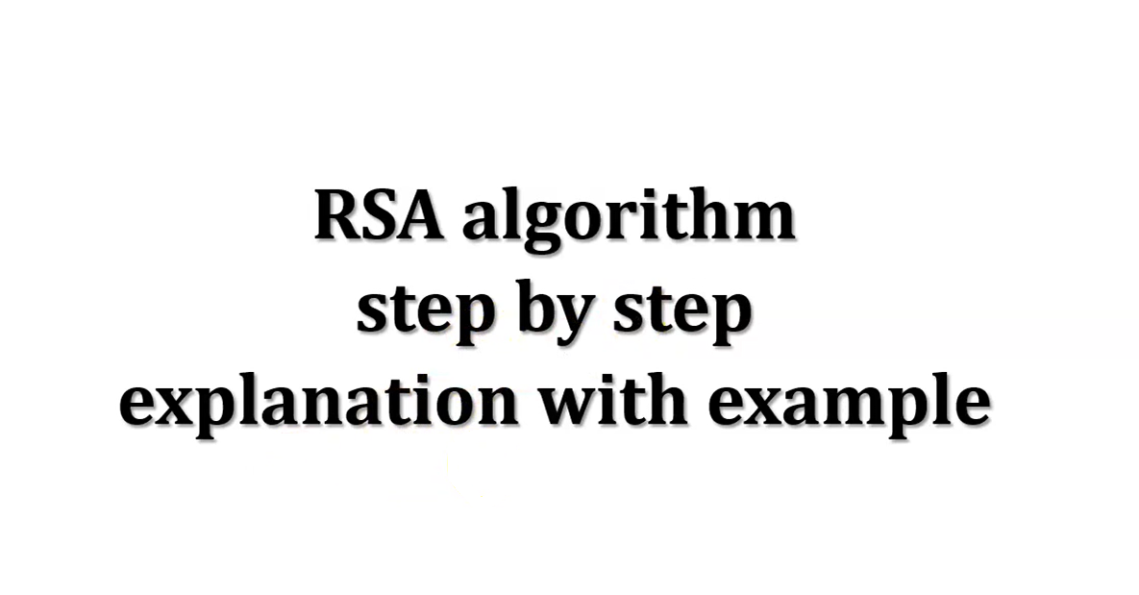

Slide 4
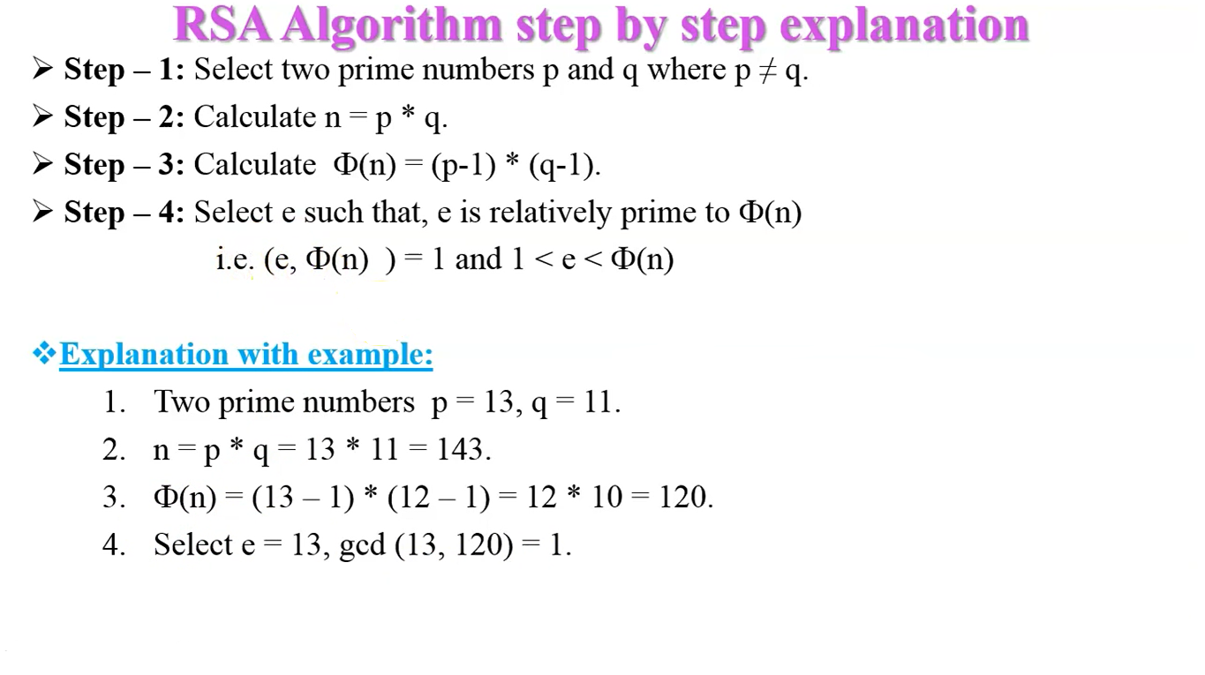

Slide 5
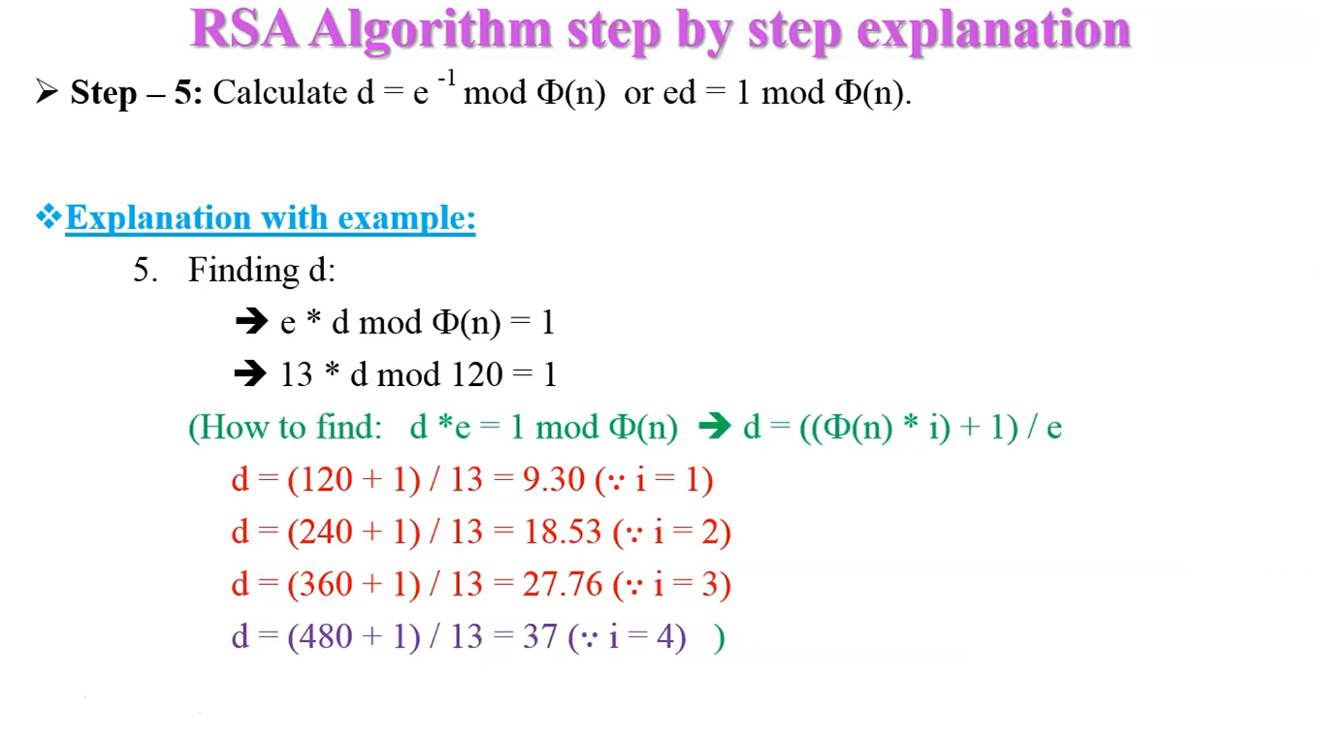

Slide 6
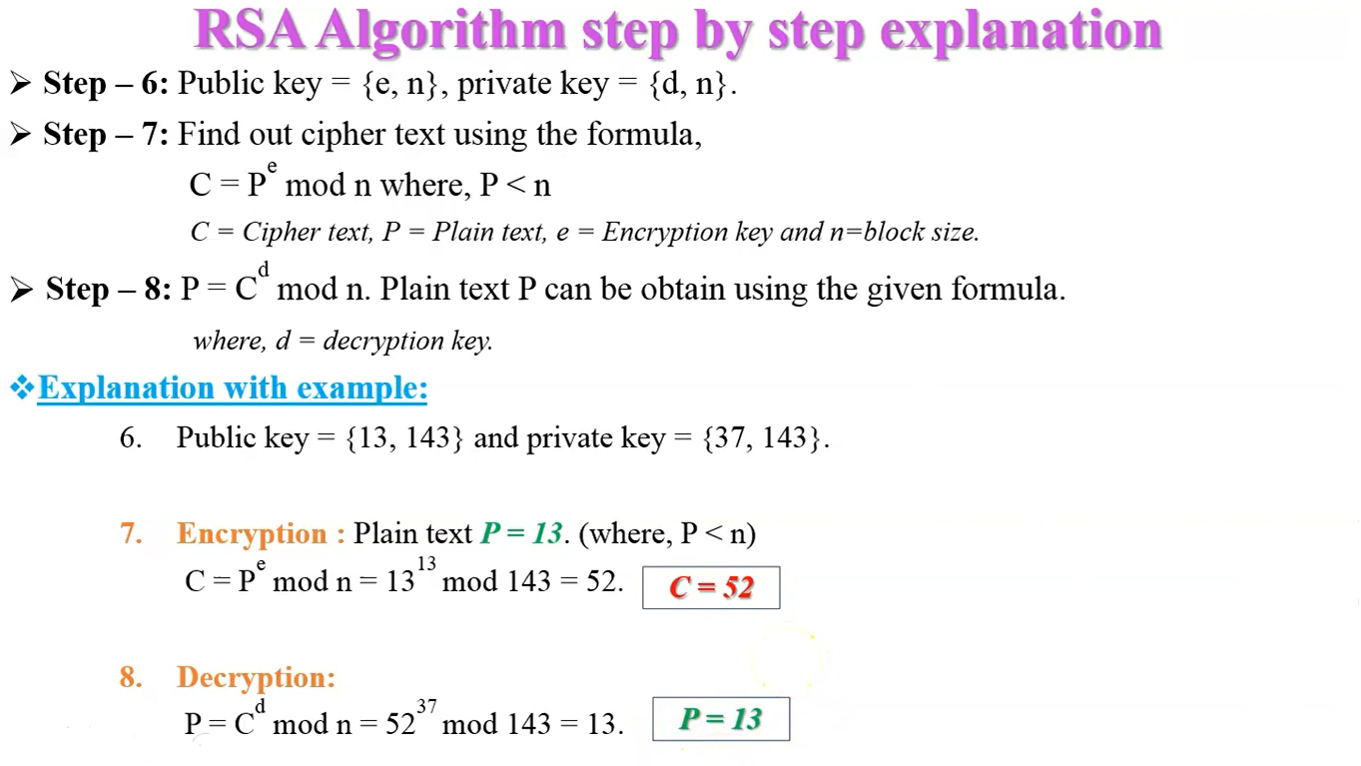

Slide 7


